Slide 1
Prospecting List Buying & Selling Fundamentals
AcademicOutreach@usps.gov
Heather Snead, United States Postal Service
March, 2019
Notes:
Part of process of developing an effective marketing campaign is: how are you going to deliver your message to your audience. When using direct mail, you need to be able to reach the targets mailbox. You need a list.

Slide 2
Notes:
Today, you will learn some of the list buying and selling fundamentals to get you well on your way to an effective campaign.

Slide 3
Notes:
The end product of your mail campaign is hopefully a fun, creative piece… but in order for it to be effective…. A lot of setup and work goes on behind the scenes. An effective marketer garners insights from their current customers. Who are the best customers? Worst? Can they be grouped? How can you replicate customers similar in nature?

Slide 4
Achieving Your Goals
Do you want your current customer to purchase again (or more)?
Do you want to re-activate a customer?
Do you want to grow your customer base?
How much can you spend to acquire a new customer?
Notes:
What are your goals and how much money do you have to use on a acquiring a new customer?

Slide 5
Mailing Strategy
House Lists
Compiled Lists
Response Lists
Saturation Lists
Notes:
In order to deliver your message to your audiences’ mailbox, you need a list. There are 4 types of lists: house, compiled, response, and saturation. Each list has it strengths and its use is dependent on your overall goals and objectives of the campaign.

Slide 6
House Lists − Past and current customers whose contact information you have or people who have expressed interest in your product or service.
Drawbacks
Benefits
Some form of relationship exists and likely to be responsive. No need to rent or buy a list which saves you money.
Doesn’t grow your customer base. Wrong offer might alienate recipient and potentially damage the relationship.

Slide 7
Compiled Lists − Names & addresses collected from various (usually public) sources and grouped together based on similar characteristics (such as demographics, geographic, psychographics, etc.).
Benefits
Can have larger universes and may reach new customers.
Drawback
Doesn’t necessarily mean they have shown interest in your product/service or something like it.

Slide 8
Response Lists − Names & addresses of individuals who responded to a product/service. Can be purchaser or hand-raiser.
Benefits
Drawbacks
Shown interest and have taken some form of action for a particular product/service.
Reach potential new customers.
Can be more expensive per name and universe size typically is smaller.

Slide 9
Saturation Lists − Addresses of households in a specific geographic location.
Benefits
Drawbacks
Usually cheaper to purchase and good when products/services are based on foot traffic (local stores).
Targets everyone in a given location. Names are not always included (just address).

Slide 10
Involved parties
List Owner
List Buyer
List Broker

Slide 11
List Owner − Owns a collection of individuals’ contact information.
Risk
Strategy
Can rent names and addresses for profit or exchange (swap/trade) with companies who have similar audiences.
May lose customers to competitor.

Slide 12
List Buyer− Purchases/rents a collection of names and addresses.
Benefit
Access to new names of potential new customers.
Drawback
Costs money to rent names that may or may not respond to your offering.

Slide 13
List Broker − Liaison between list buyer and seller. Brokers will provide a data card for buying consideration and facilitate the actual exchange of contact information of the individuals if purchased/rented.
Benefits
Drawback
Skilled in building list plans/strategies that incorporate many different lists (helps offset risk).
Has relationships with list owners & can negotiate better deals.
Can do administrative tasks if there are several transactions.
Compensated by list owners.

Slide 14
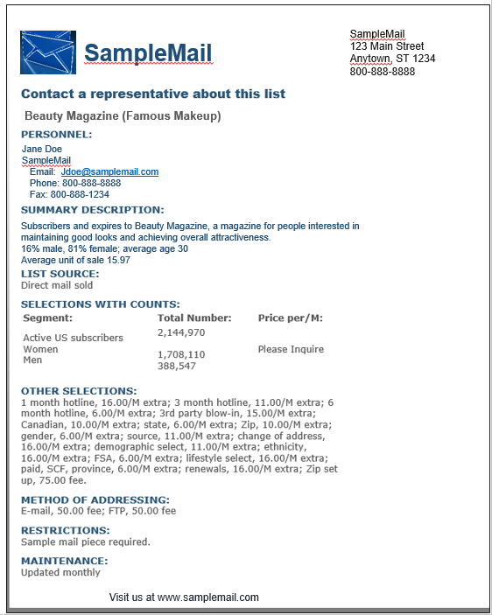
Data Card − Marketing documentation provided by list broker describing the mailing list.
List Owner/Name
List Broker
List Segment
List Selection

Slide 15
Analyze the Results
What have past results been for similar campaigns?
What are industry standards?
What were the campaigns goals?

Slide 16
Campaign Parameters− Set up unique codes to capture response by each list. −Require a code (unique to list) to redeem a discount. −Have unique URL for each list.
Code | List Name | Universe Size | Mail Qty | Orders | RR%* | Net Sales @ $79 | List Cost | Add’l cost (print, production, etc.) @ $0.29 | ROI**
Exa1 | Example | 385,547 | 10,000 | 139 | 1.39% | $10,981 | $1,200 | $2,900 | 168%
Sam1 | Sample | 5,025 | 3,000 | 25 | 0.83% | $ 1,975 | $ 387 | $ 870 | 57%
*Response Rate (RR%)
**Return on Investment (ROI)
RR%= Orders/Mail Qty
ROI= Campaign Profit/Campaign Expense

Slide 17
Maximize Efforts −
Identify lists with ROI that met your goals and re-mail.
Cast wider net (test additional selects in the list).
Ask list owner repeat usage history (who else uses the list regularly? Do these users rent their lists? If so, test).
Identify lists close to targeted ROI. If you tighten the select/ add more criteria, would they perform well? If so, test.
Code | List Name | Universe Size | Mail Qty | Orders | RR% | Net Sales @ $79 | List Cost | Add’l cost (print, production, etc.) @ $0.29 | ROI
Exa1 | Example | 385,547 | 10,000 | 139 | 1.39% | $10,981 | $1,200 | $2,900 | 168%
Sam1 | Sample | 5,025 | 3,000 | 25 | 0.83% | $ 1,975 | $ 387 | $ 870 | 57%

Slide 18
Scenario

Slide 19
Background: You are a Marketing Manager for a company that sells subscriptions of “beauty in the box”. Based on historical data, you know that your acquisition campaigns can have a 0.90 ROI. (Customers will become profitable after a few months).
Assignment: Develop a marketing strategy using mail that grows the subscriber base.
Budget: $75,000

Slide 20
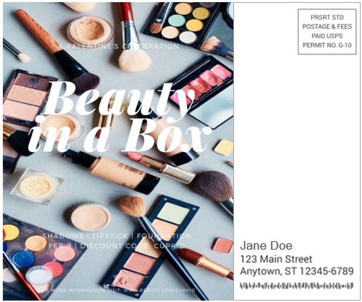
Creative − Your creative was already developed and approved.

Slide 21
Audience
Through keen insights, research, and analysis of your current customers, you confirm that your ideal audience is:
Female
Between age 25-35
Active professionals
Health & beauty conscious

Slide 22
Strategy− You decided to grow the customer base by acquiring new customers and re-activating lapsed subscribers.
House Lists
Prospect Lists
You are able to work with your internal group to pull customers that have lapsed in their subscription. The information you have pulled is:
Names
Addresses
Recency of last purchase
How much they spent
How do you find and get similar information for potential new customers?

Slide 23
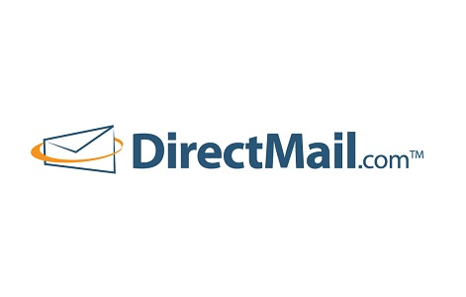
List Broker
You reach out to a list broker to help find new customers who fit your target audience.
There are several companies that offer these services but you choose from one of these:

Slide 24
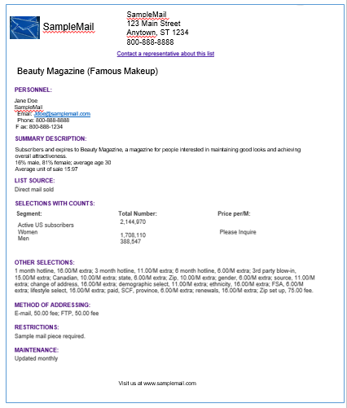
List Recommendations
You receive:
A stack of data cards and
Spreadsheet with forecasted ROI
Code | List Name | Universe Size | Mail Qty | Projected RR% | Net Sales @ $79 | List Cost | Add’l cost (print, production, etc.) @ $0.29 | ROI
Beau | Beauty Magazine | 385,547 | 50,000 | 0.98% | $38,710 | $10,00 | $2,900 | 162%
Fit | Fitness & You | 36,603 | 10,000 | 0.80% | $ 6,320 | $ 187 | $ 870 | 57%

Slide 25
List Plan
Reminder: Your target ROI is 0.90; Budget is $75,000 and goal is to grow your subscriber base.
Which lists do you select and why?
Code | List Name | Universe Size | Mail Qty | Projected RR% | Net Sales @ $79 | List Cost | Add’l cost (print, production, etc.) @ $0.29 | ROI
Hou | House List | 24,500 | 24,500 | 3.40% | $65,807 | $0 | $7,105 | 8.26
Beau | Beauty Magazine | 385,547 | 50,000 | 0.98% | $38,710 | $10,000 | $14,500 | 0.58
Fit | Fitness & You | 36,603 | 10,000 | 0.80% | $6,320 | $1,500 | $2,900 | 0.44
Waw | Women at Work | 22,965,341 | 50,000 | 0.50% | $19,750 | $9,000 | $14,500 | (0.16)
Vbm | Vitamins by Mail | 450,000 | 50,000 | 0.39% | $15,405 | $5,500 | $14,500 | (0.23)
Dru | Dress R Us | 67,429 | 50,000 | 0.29% | $11,455 | $8,750 | $14,500 | (0.51)
 | Total | 23,929,420 | 234,500 | 0.85% | $157,472 | $34,750 | $68,005 | 0.53
Under ROI
Over budget
$102,755
Notes:
RR%= Orders/Mail Qty
ROI= Gains-Investment Cost/Investment Cost

Slide 26
Marketing Campaign −
Congratulations, you have completed your first successful campaign!
Code | List Name | Mail Qty | Projected RR% | ROI
Hou | House List | 24,500 | 3.40% | 8.26
Beau | Beauty Magazine | 50,000 | 0.98% | 0.58
Fit | Fitness & You | 10,000 | 0.80% | 0.44
Waw | Women at Work | 50,000 | 0.50% | (0.16)
Vbm | Vitamins by Mail | 40,000 | 0.39% | (0.20)
Dru | Dress R Us | 50,000 | 0.29% | (0.51)
 | Total | 174,500 | 1.04% | 0.91

